Slide 1
FIRST ROBOTICS: Design Strategy
Nolan Conway
Webb Institute
11/22/14

Slide 2
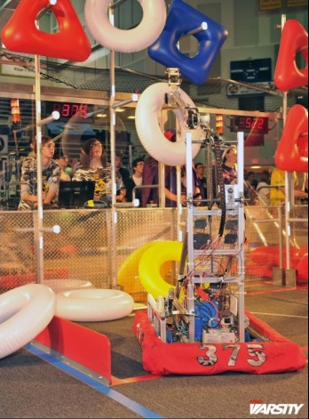
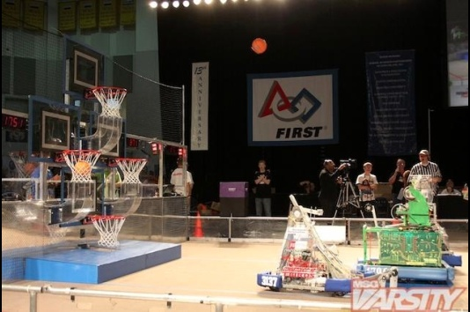
First Games
Main objective is to score points
Usually there are too many tasks for a single robot to complete on its own
Usually 2 minutes
(time is a problem)

Slide 3
5 Simple Steps to Design
1: Know the game
2: Know your limits
3: Pick your part
4: Make tradeoffs
5: Work the details

Slide 4
Step 1: Know the game
Read the Rules
Read them again
Look at every method of scoring
Even the crazy ones Freshmen come up with
Look at all means of defense
Run practice matches in your mind
Develop strategies then look to defend them
Ask how commonly will each strategy be played?

Slide 5
The Easy Win
A “Chokehold Strategy”
A strategy that will always end in winning independent of your opponent
FIRST does not like this
Look out for the Q & A or rule updates

Slide 6
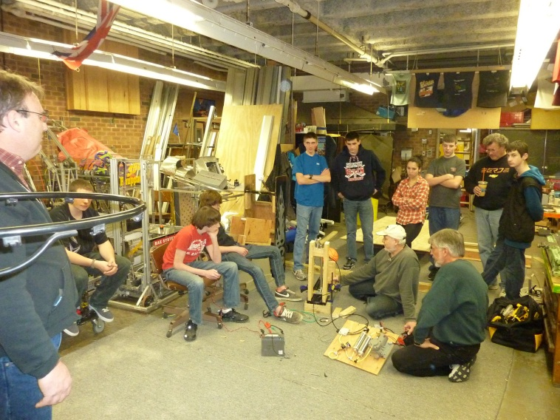
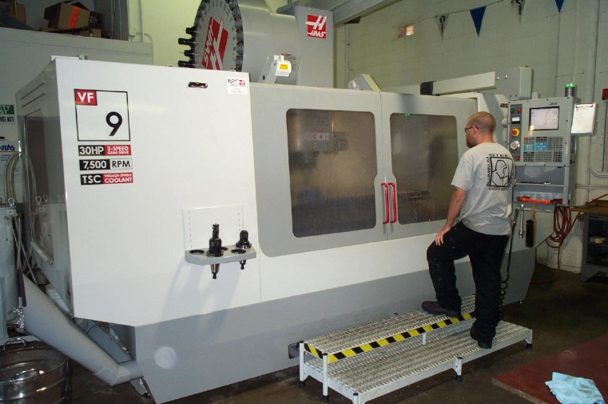
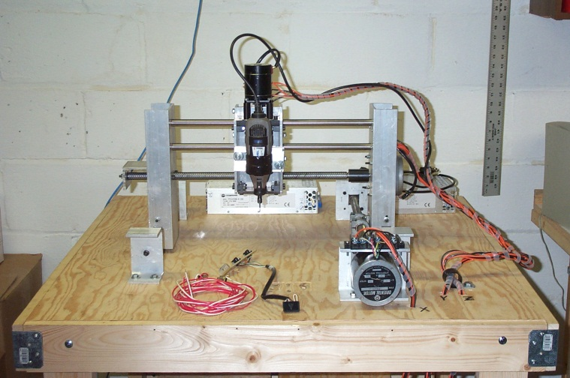
Step Two: Know Your Limits
Every Team has them!
Space
Build time
Machinery/ Tools
Knowledge
Cost
Simpler is
Better

Slide 7
Step 3: “Pick Your Part”
Prior to this you should know:
The other robot types that will exist
The rules……all of them
What is worth doing
Prioritize
Scoring, defense, the middle-man, end game
Remember: You are an alliance
You can rely on the other robots to do some things
You cannot guarantee an alliance

Slide 8
For What it is Worth….
Is a task worth the reward for accomplishing it?
You want an easy task that scores big points
How long will it take?
3 seconds to score a 1-point basket or….
30 seconds to score a 5-point bonus
Defense is just as rewarding
10 points kept out are the same as 10 points in
How much weight is dedicated to a single task?
Know the ranking system!

Slide 9
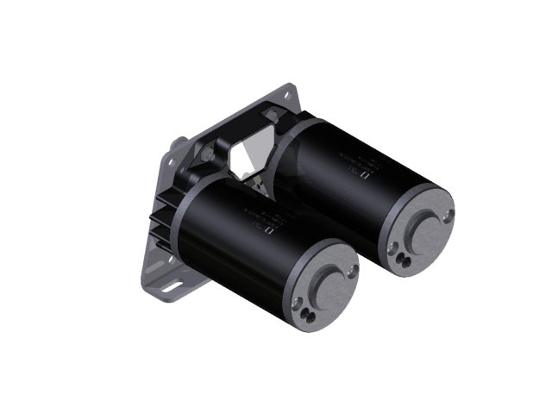
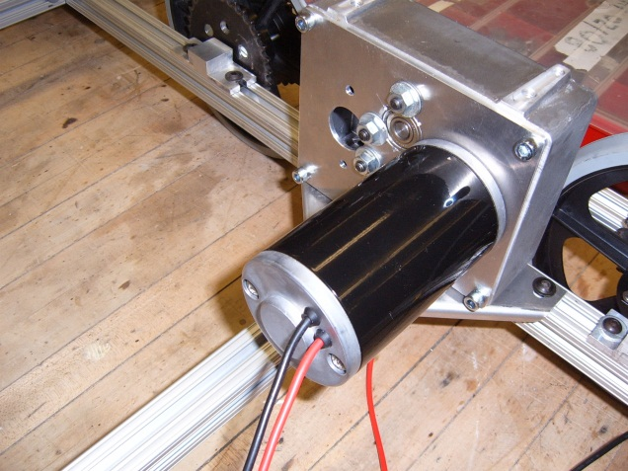
Step 4: “Make Tradeoffs”
The robot has limits
Your analysis should help you with this
Speed vs. Power
Complexity vs. Durability
Motor Placement
Notes:
To build one item may leave no room for the next

Slide 10
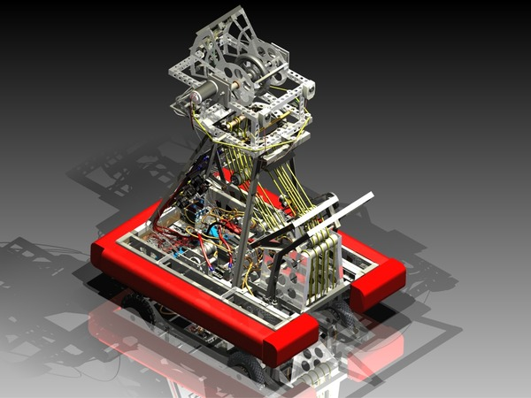
Step 5: “The Details”
Decide on a drive train
Think of materials
Begin to sketch and draw your design
Get on the same page!
Brief the whole team

Slide 11
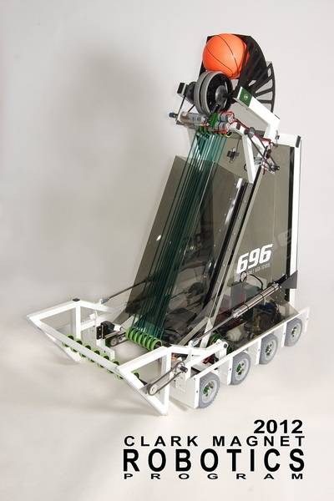
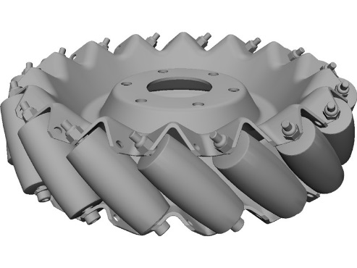
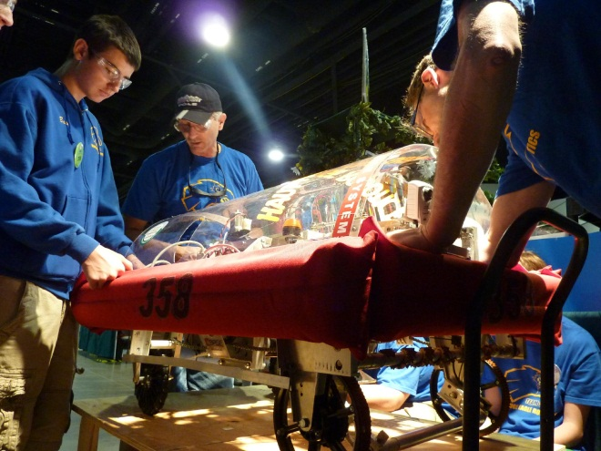
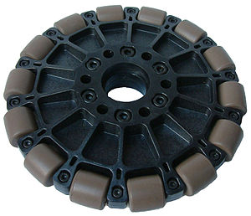
Drive Train Selection
Choose a system that matches your strategy
Think of your programmers, and drivers
Mobility
Weight
Drivability
Calculate expected speed

Slide 12
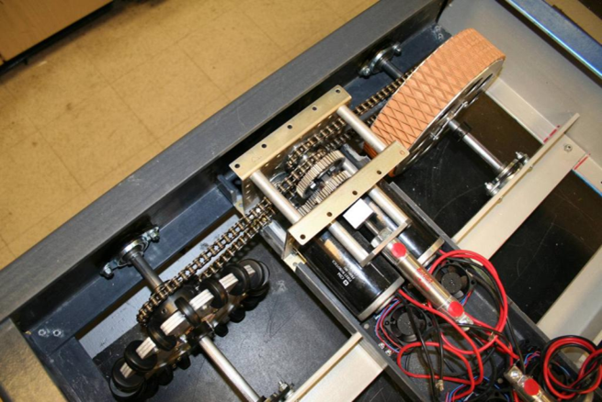
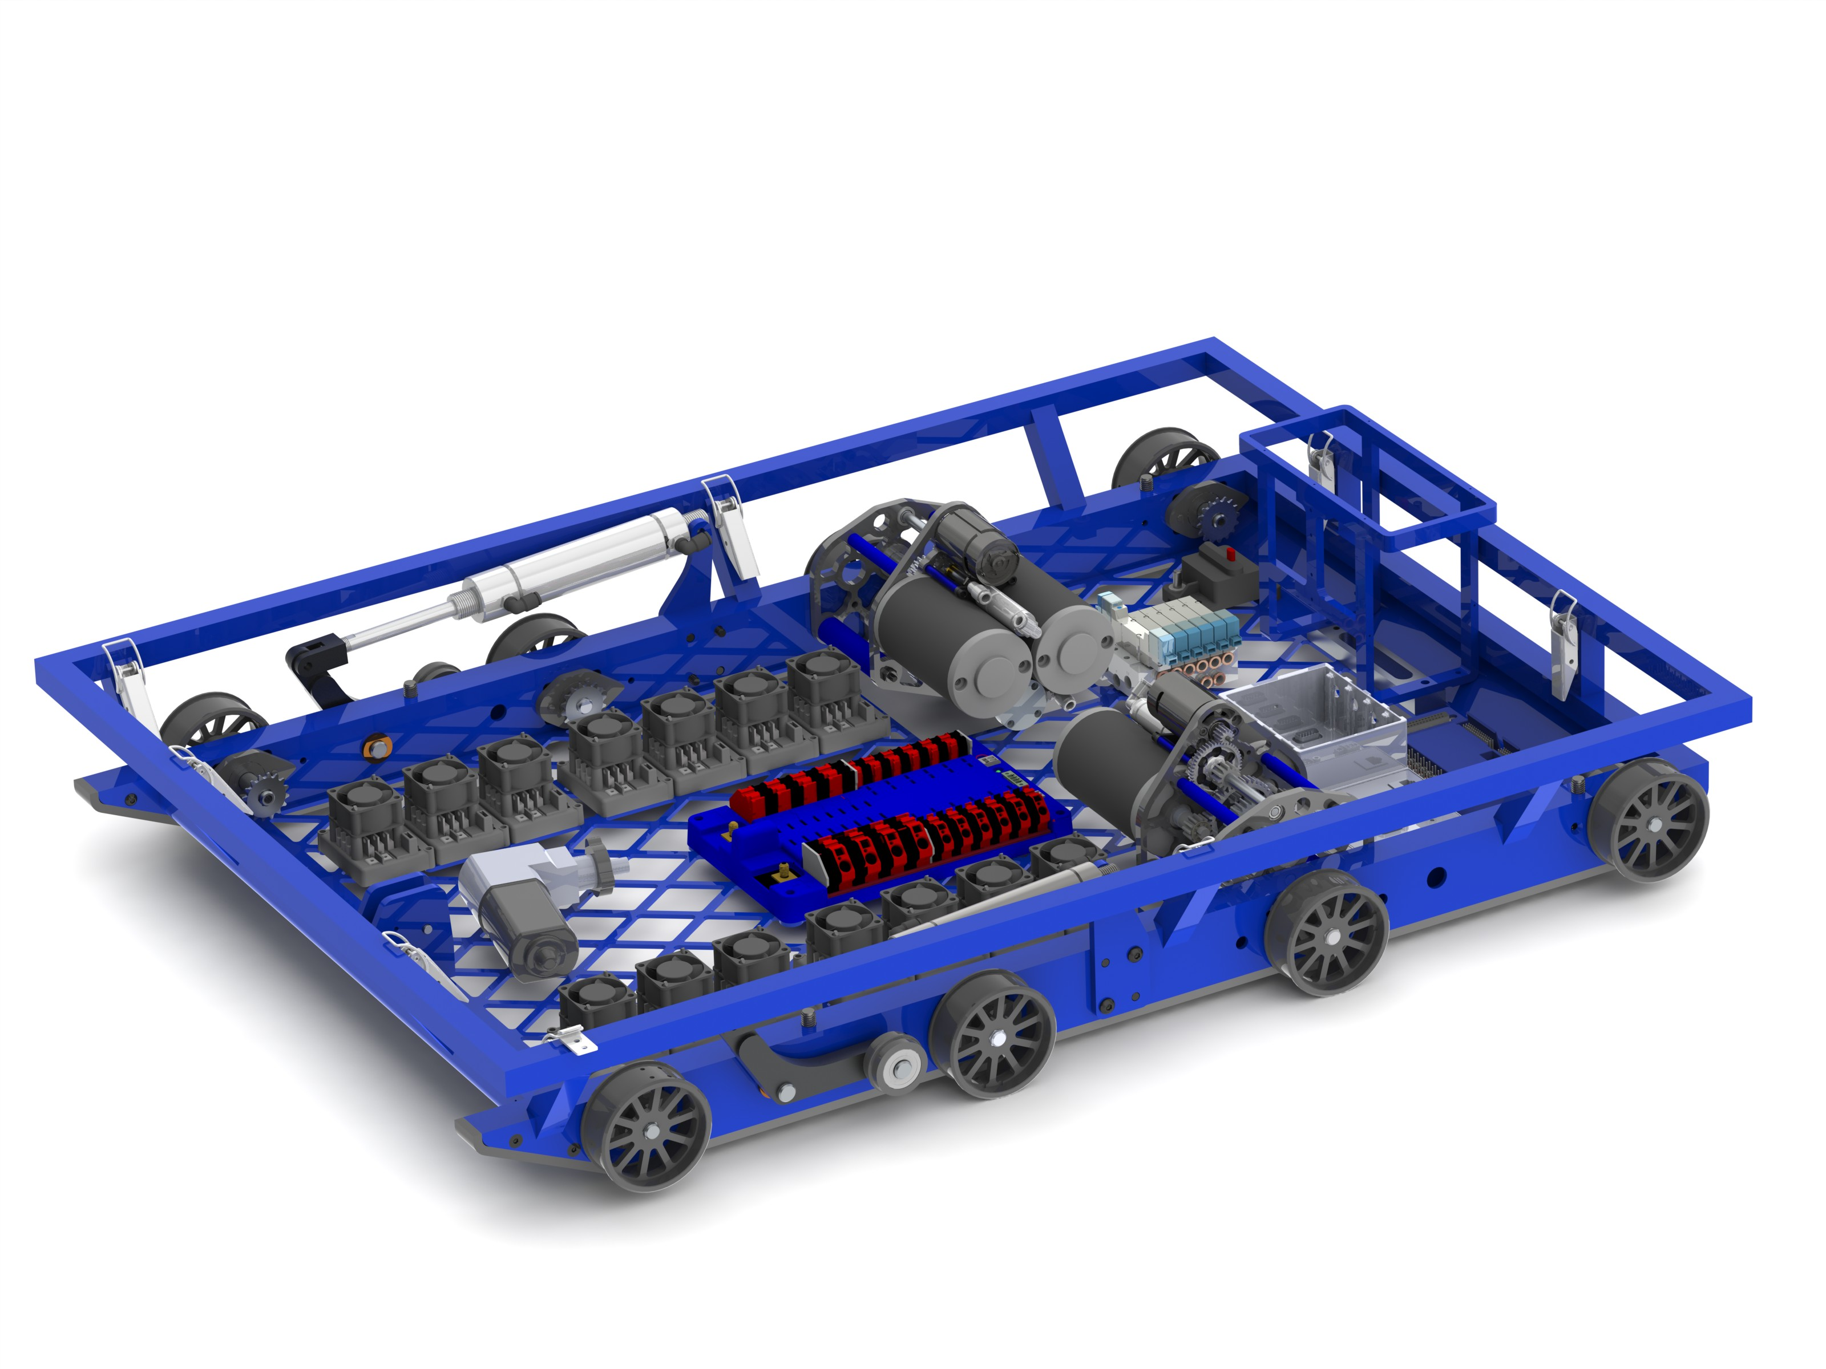
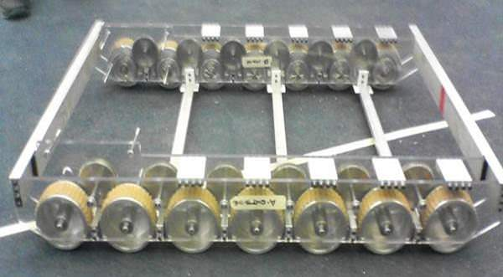
Tank Drive
2, 4, 6, 8 wheel drive
West coast (cantilevered wheels)
Offset center wheel
Speed guidelines:
3 ft/s: Pushing
4-7 ft/s: slow/pushing
8-12 ft/s: quick with some push
13+ ft/s: very fast, hard control

Slide 13
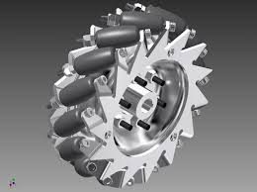
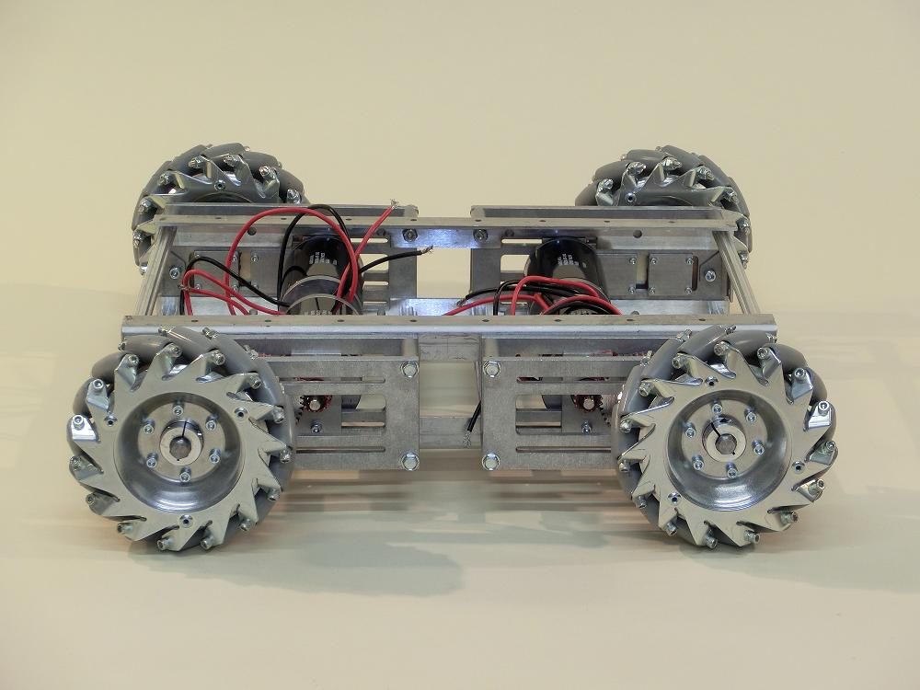
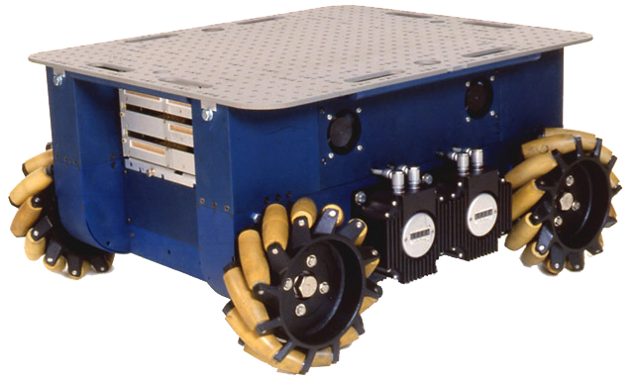
Mecanum
71% of Power in primary
50% Perpendicular
Easy to program
Expensive/heavy
Notes:
Sqrt(2)

Slide 14
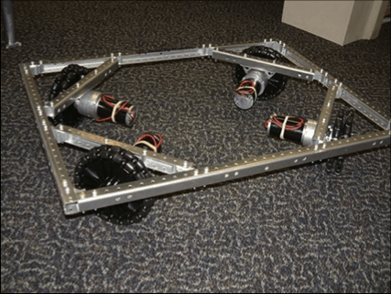
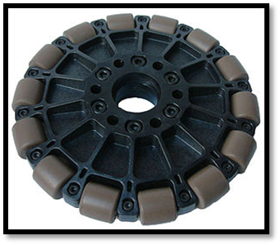
Holonomic (Omni)
Harder to program
Same power as mecanum
Higher efficiency
No resistance to push
Notes:
Less mass to rotate

Slide 15
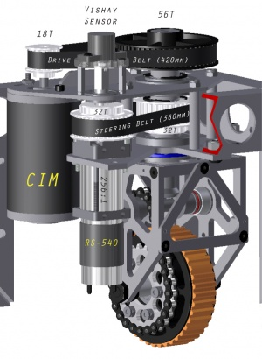
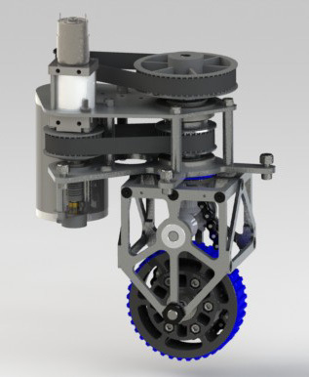
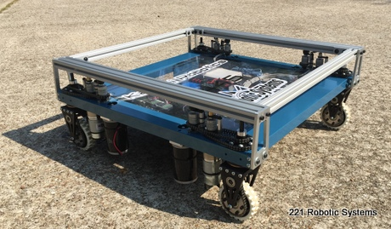
Swerve
Requires independent motors
Save motors with crab drive
Very strong pushing
A lot of programing
Pneumatic option
Notes:
Some teams combine two sets of wheels. Less motors (crab drive)

Slide 16
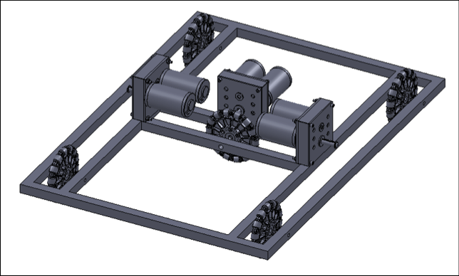
Slide
You will be pushed
Direction is simple summation of movements
Smooth movement anywhere you want

Slide 17
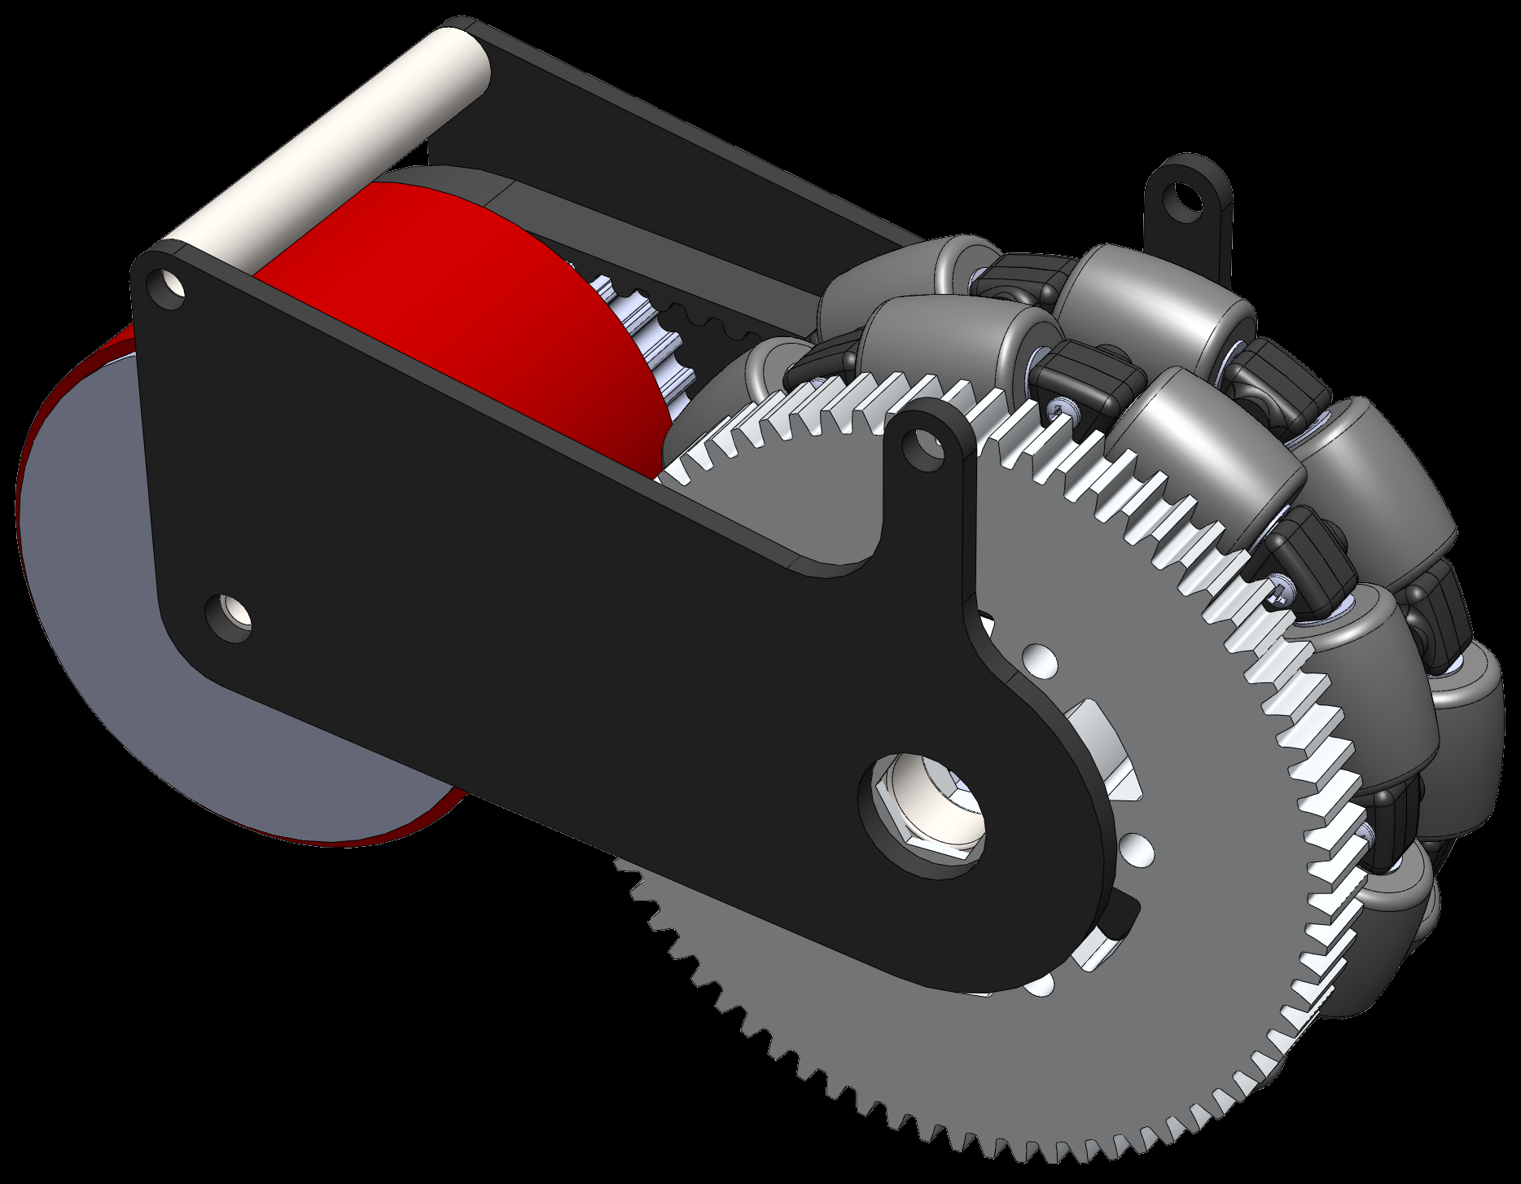
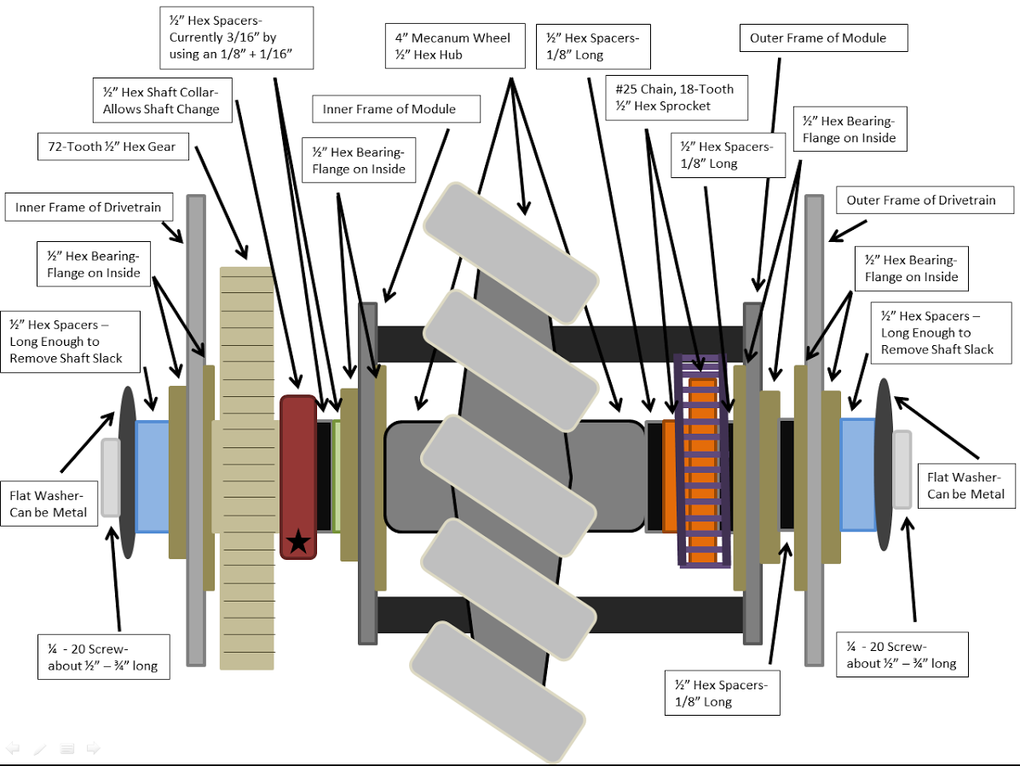
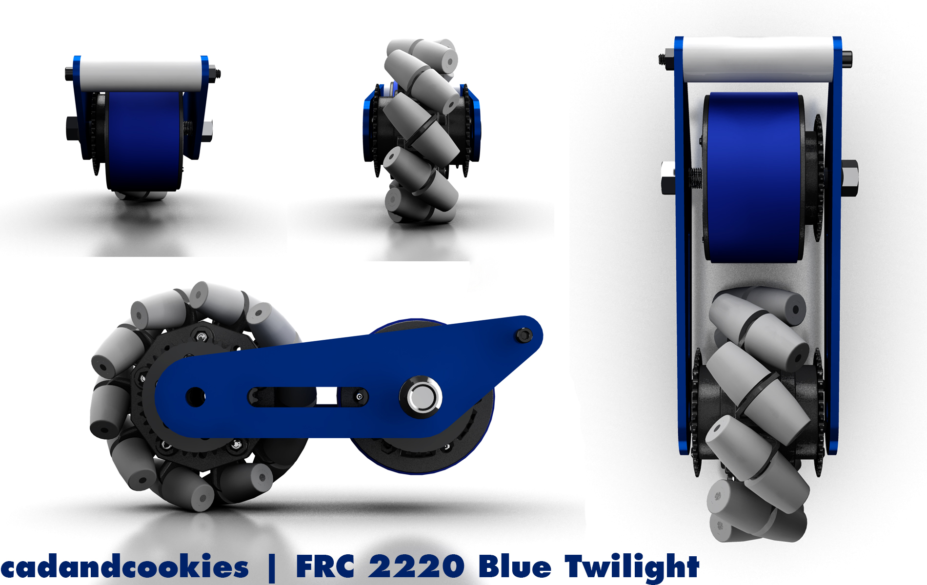
Butterfly
Pneumatics required
Large maneuvering wheel
Small traction wheel
Combine any two drive trains

Slide 18
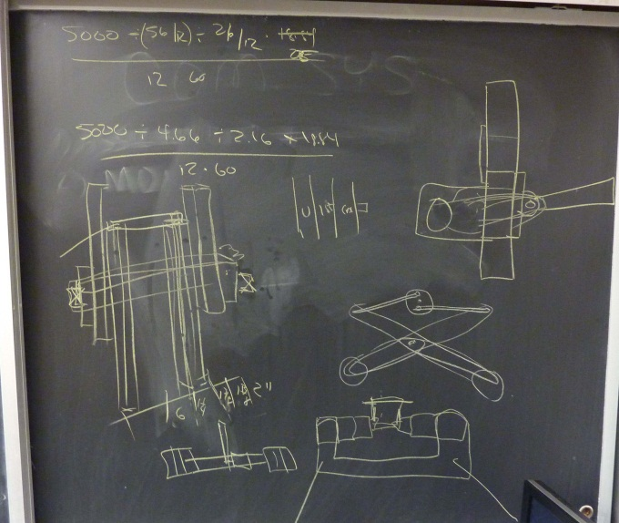
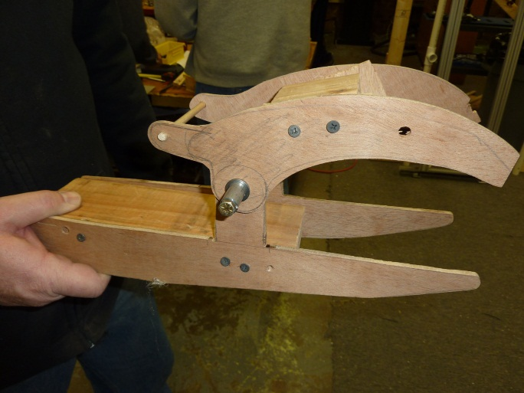
In Practice
Brainstorm
Prototype
Try what you don’t already know
Decide on a plan
Order Material
Create a detailed design
Build!
Notes:
Use your resources (Chief Delphi)

Slide 19
Wiggle Room
Leave a little bit of it…
If the maximum width is 26 inches, make the robot 24 inches
You may need extra space for new mechanisms
You must fit in the size-box at competition
Leave your self some spare weight
All scales are a bit different (look at tolerances)
You may need to add bolts or even whole pieces
No one likes a cheese-hole robot

Slide 20
Materials
Things sell out
Be careful with Andy-Mark
Robotics-specific items sell out very fast
Look for donations of scrap metal
Keep things Standard (1/4-20)

Slide 21
Design Tips
Avoid shoulders, grooves or features on active shafts
Set screws do not transfer load!
Chain vs. belt
Belt saves 2-lbs for 6-wheel drive
Same stretch, belt is 2% more efficient
Gears trade speed for torque (cant get both)
Shift weight from center
Wheel size should be a big choice

Slide 22
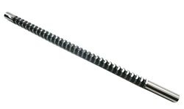
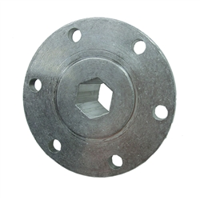
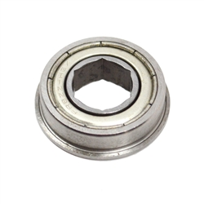
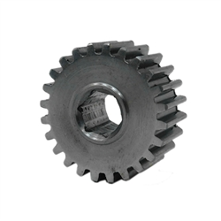
Hex Drive or Standard
One or the other!
Requires a hex broach to switch ($235)
Lower stress concentrations then keyway
Easier to assemble
Live verse dead axel
Reduces chance of shaft twisting

Slide 23
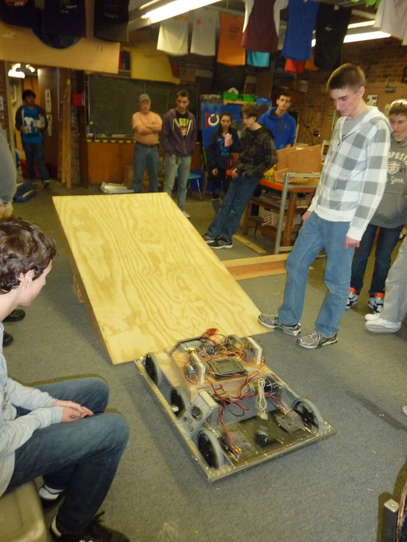
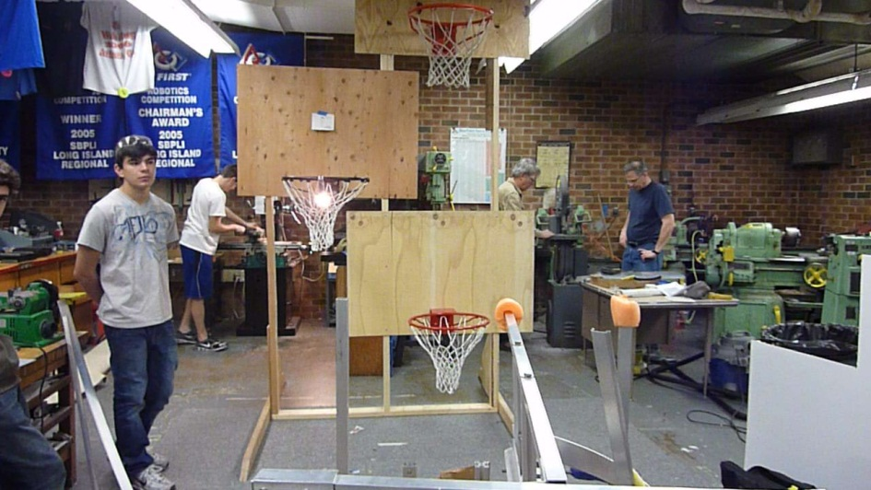
Practice Field
Build one…..
Or at least pieces of it
Wood is quick, cheap, and easy
Build it right!
Use it for prototyping and driver practice
Notes:
For practice field: No point if dimensions are wrong

Slide 24
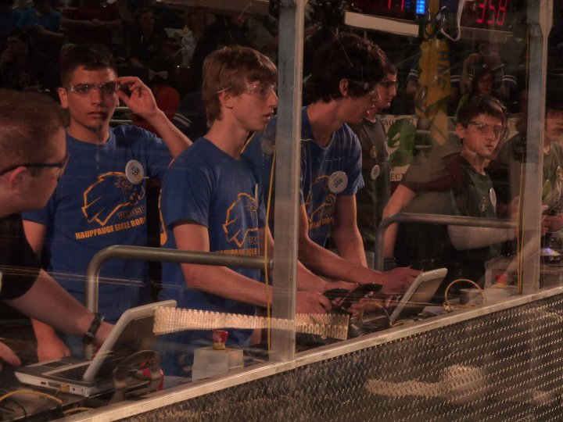
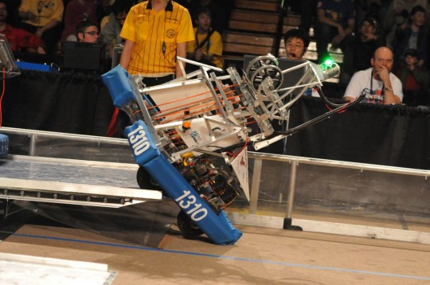
Drive, Drive, Drive!
Experience is essential for drivers
Drive a similar robot if available
Practice turns, corners, & fine-maneuvering
Teams that do two regionals have an edge
Practice driving with a coach

Slide 25
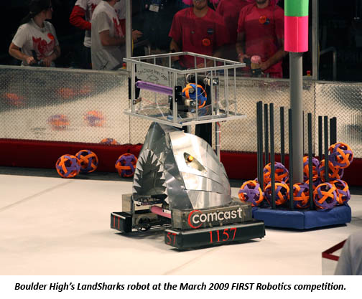
The Cool Factor
Make your robot “POP”
Decorations are important
Clean construction Autonomous movement
A bright color or stand out feature
All of these will help you be scouted!

Slide 26
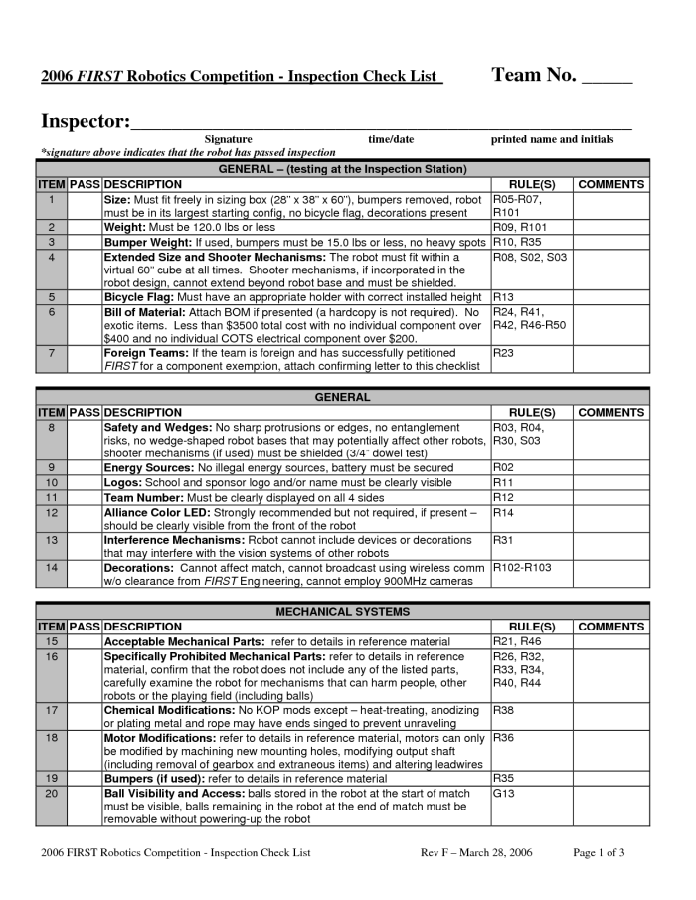
Inspect Your Robot
Print the inspection sheet from the FIRST website and USE IT!
From inspections last year:
Wire size (check the CIMs)
Have bumpers ready
Be inside the bumper-zone
Bumper zone (height/ gaps)

Slide 27
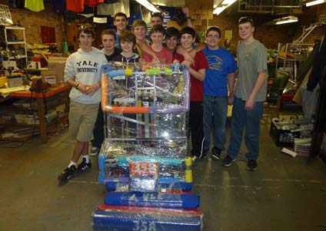
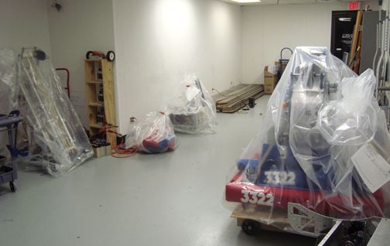
Say Goodbye
Almost time to relax but…
Take Measurements
Helpful if you need to make changes
Be smart about your with-holding allowance
Take a lot of reference photos
Put the bumpers on the robot
Be careful with your Bag….it may tear!
Take a break and relax once it is done

Slide 28
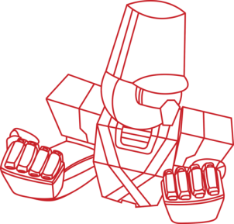
More Information
Chief Delphi- white papers
www.Simbotics.org
www.team358.org
Email: nconway15@webb.edu

